Slide 1
Pacific Lamprey Translocation
Confederated Tribes of Grand Ronde
Bryan Fendall
Aquatic Biologist

Slide 2
Pacific Lamprey Significance
Confederated Tribes
of Grand Ronde
Spiritual
Medicinal
Subsistence

Slide 3
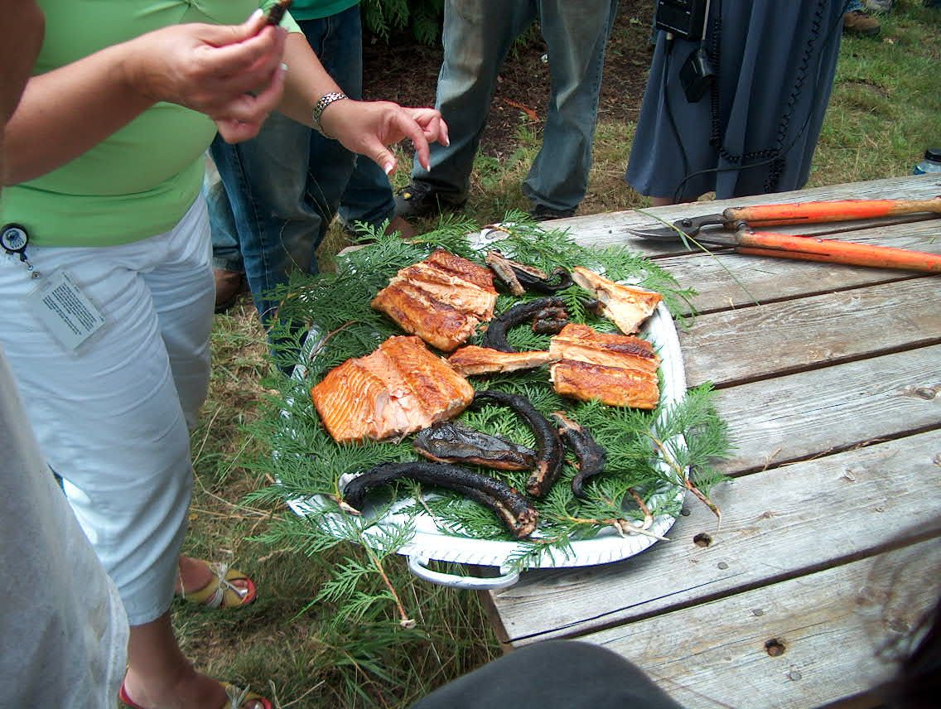
Pacific Lamprey Significance
Confederated Tribes
of Grand Ronde
Trade & Gift Giving
Way of Life

Slide 4
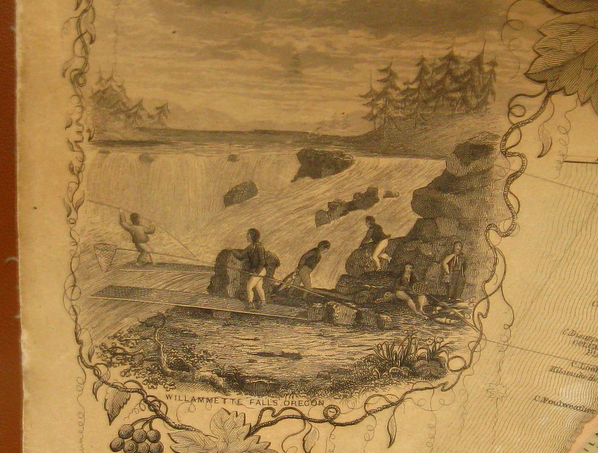
Pacific Lamprey Status
Confederated Tribes
of Grand Ronde
Historic
Willamette Basin
Current
In Decline

Slide 5
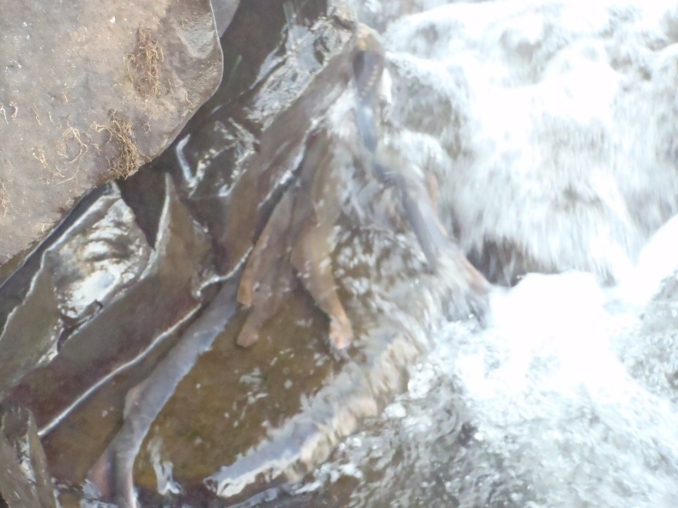
Pacific Lamprey Significance
Confederated Tribes
of Grand Ronde
To better understand the decline, Grand Ronde has taken an active role in Pacific lamprey research

Slide 6
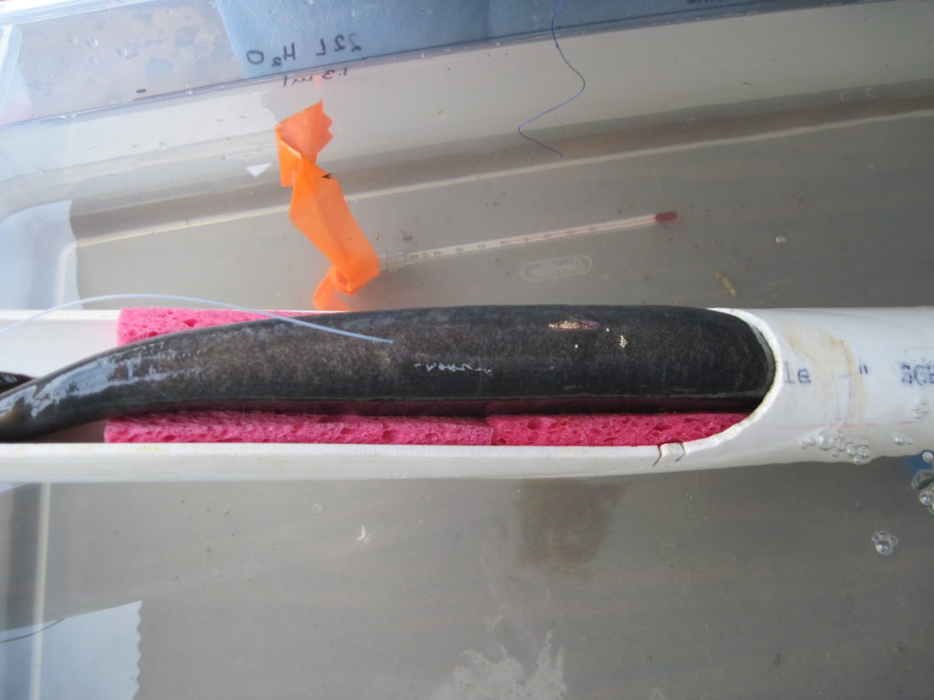
Pacific Lamprey Research
Confederated Tribes
of Grand Ronde
Migration behavior study
2008 - 2012
Radio-telemetry
Willamette Falls
Notes:
Cut or move

Slide 7
Pacific Lamprey Research
Confederated Tribes
of Grand Ronde
Location of 22 fixed telemetry receiver sites
Mainstem and tributaries
Notes:
Old Project short description

Slide 8
Pacific Lamprey Research
Confederated Tribes
of Grand Ronde
Data
Relative use patterns of spawning tributaries
Migratory and tributary selection behaviors were variable
What environmental factors drive selection
Explore adult reintroduction
Determine if juvenile pheromones influence adult tributary selection

Slide 9
Pacific Lamprey Translocation
Confederated Tribes
of Grand Ronde
Translocation Pilot Study
Reintroduce adult lamprey to historic spawning habitat
Pacific lamprey
Ascend high gradients
Observed in high gradient tributaries, successfully locating suitable spawning habitats
Fall Creek
Telemetry data detected adults entering Coast Fork, similarly high in system
Streams known to sustain lamprey spawning have common habitat attributes observed above dam

Slide 10
Pacific Lamprey Translocation
Confederated Tribes
of Grand Ronde
Fall Creek
Adult passage naturally occurs in Middle Fork
Aerial tracking detected adults close to both Fall Creek & Dexter Dams (Clemens et al. 2012)
Ammocoetes present in Middle Fork below Fall Creek
Reservoir drains to run of the river
Juvenile out-migration is feasible

Slide 11
Pacific Lamprey Translocation
Confederated Tribes
of Grand Ronde
Fall Creek
Proximity to Middle Fork
No known lamprey passage issues
LPS could be feasible at potentially low cost
Lamprey ramp
Truck and haul

Slide 12
Pacific Lamprey Translocation
Confederated Tribes
of Grand Ronde

Slide 13
Pacific Lamprey Translocation
Confederated Tribes
of Grand Ronde
Translocation Project
Capture adults from Willamette Falls
Transport to Fall Creek via truck
Release
Successful Pacific lamprey reproduction above dam
Determine if juvenile pheromone presence will cause adults to approach and attempt passage of dam

Slide 14
Pacific Lamprey Translocation
Confederated Tribes
of Grand Ronde
Considerations
Brook known to exist both above/below
Pacific likely to exist below /not above
Pacific ammocoete surveys above/below

Slide 15
Pacific Lamprey Translocation
Confederated Tribes
of Grand Ronde
Shocking Results
Sampled 8 Sites
7 Above
1 Below
Above 578 Brook 0 Pacific
Below 0 Brook 23 Pacific

Slide 16
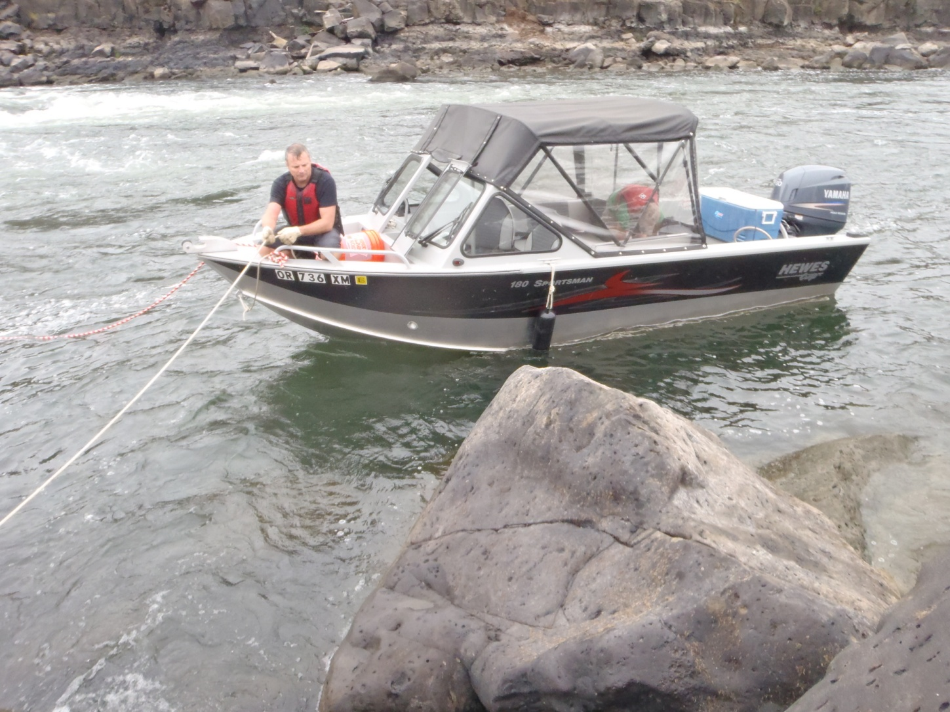
Pacific Lamprey Translocation
Confederated Tribes
of Grand Ronde
Accessing Falls to
collect adult lamprey

Slide 17
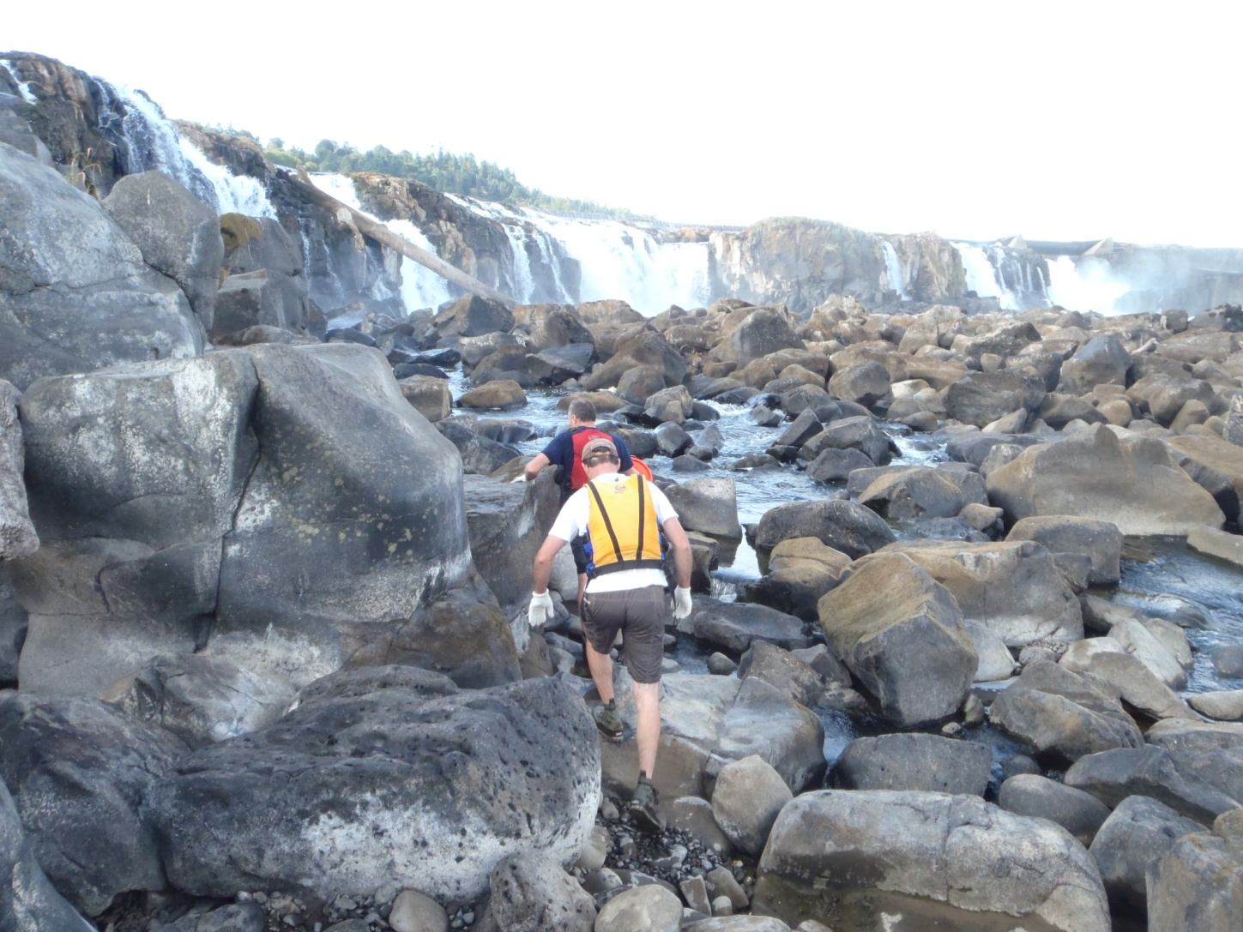
Pacific Lamprey Translocation
Confederated Tribes
of Grand Ronde
Accessing Falls to
collect adult lamprey

Slide 18
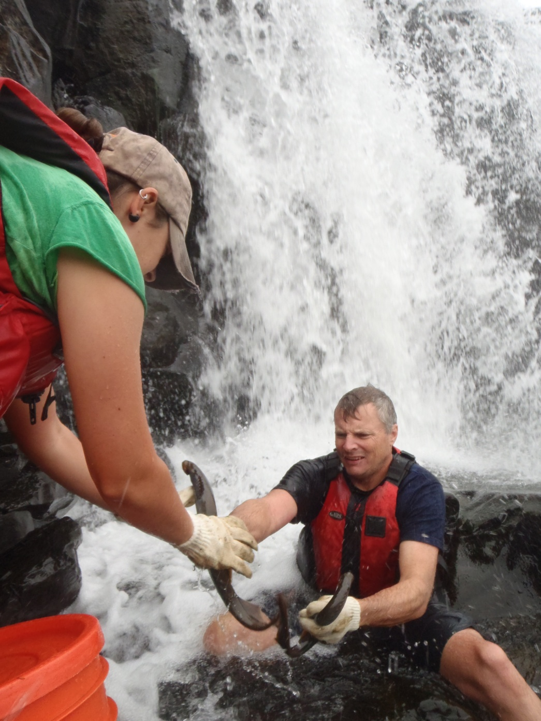
Pacific Lamprey Translocation
Confederated Tribes
of Grand Ronde
Capturing lamprey from Willamette Falls

Slide 19
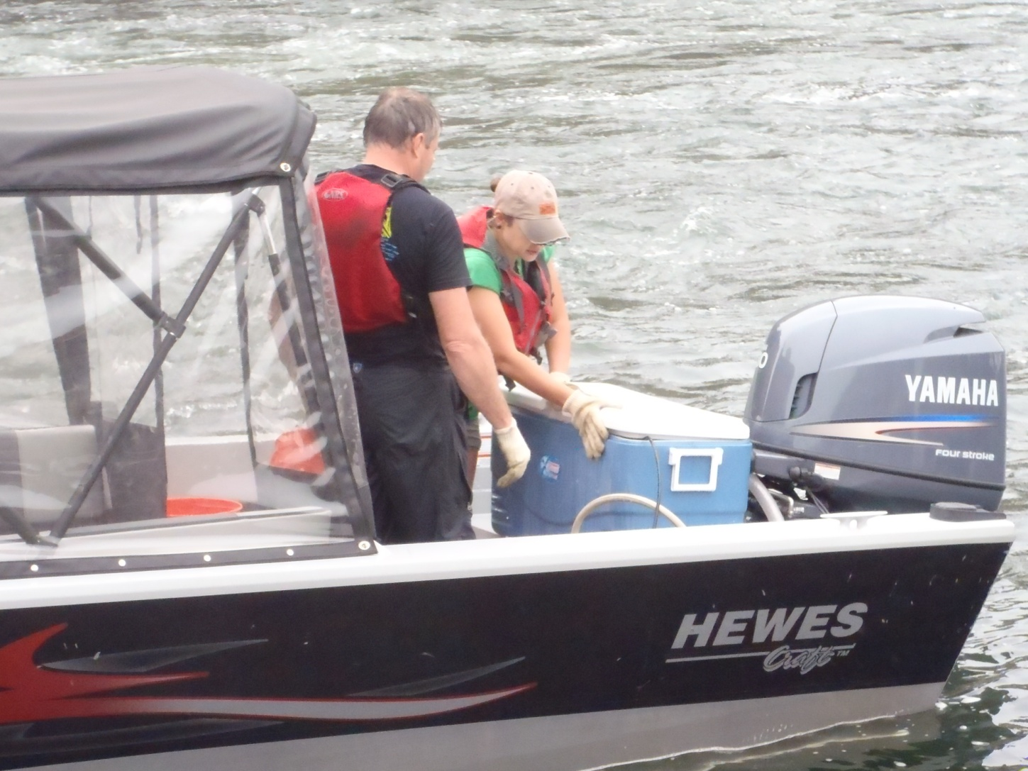
Pacific Lamprey Translocation
Confederated Tribes
of Grand Ronde
Live well transport
from Falls to truck

Slide 20
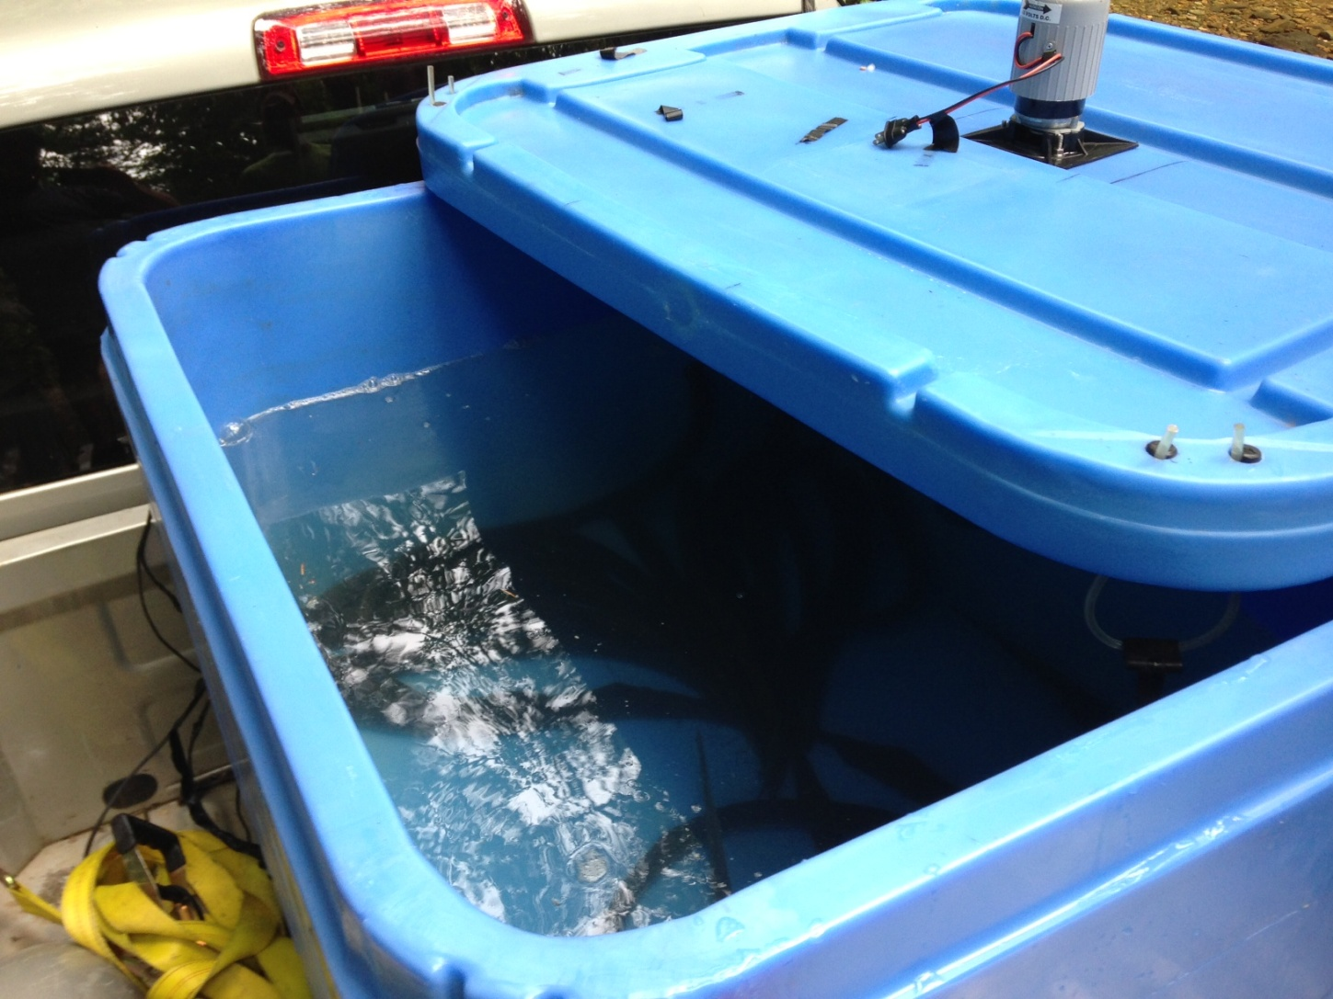
Pacific Lamprey Translocation
Confederated Tribes
of Grand Ronde
Insulated tote with agitator

Slide 21
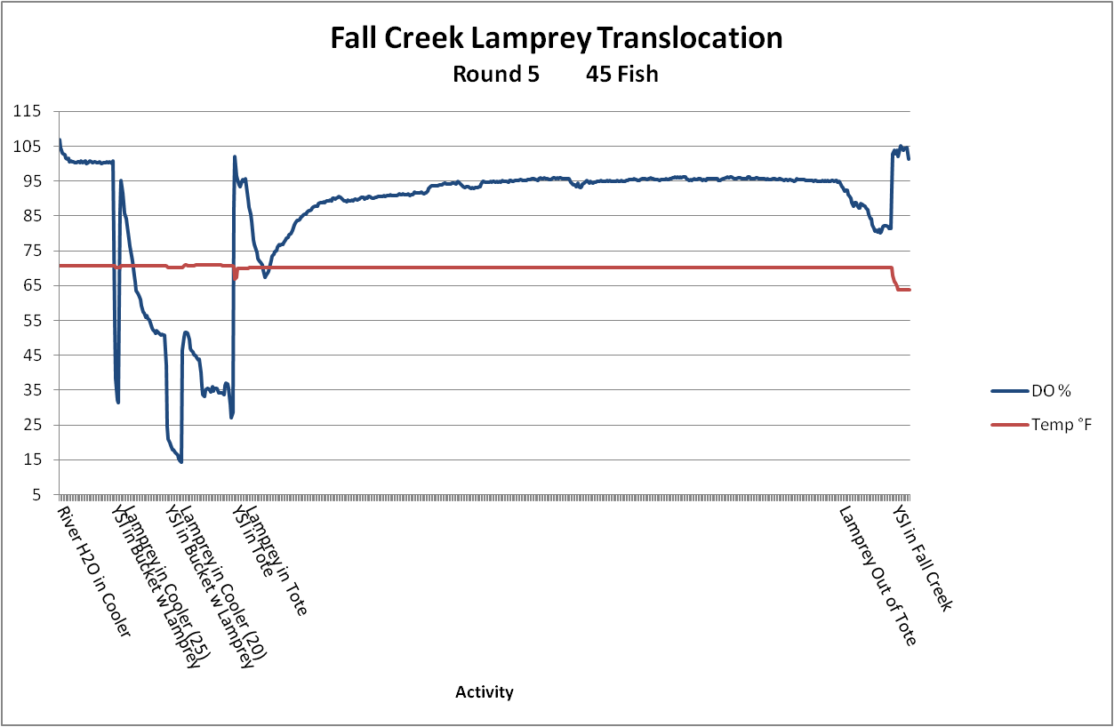
Pacific Lamprey Translocation
Confederated Tribes
of Grand Ronde

Slide 22
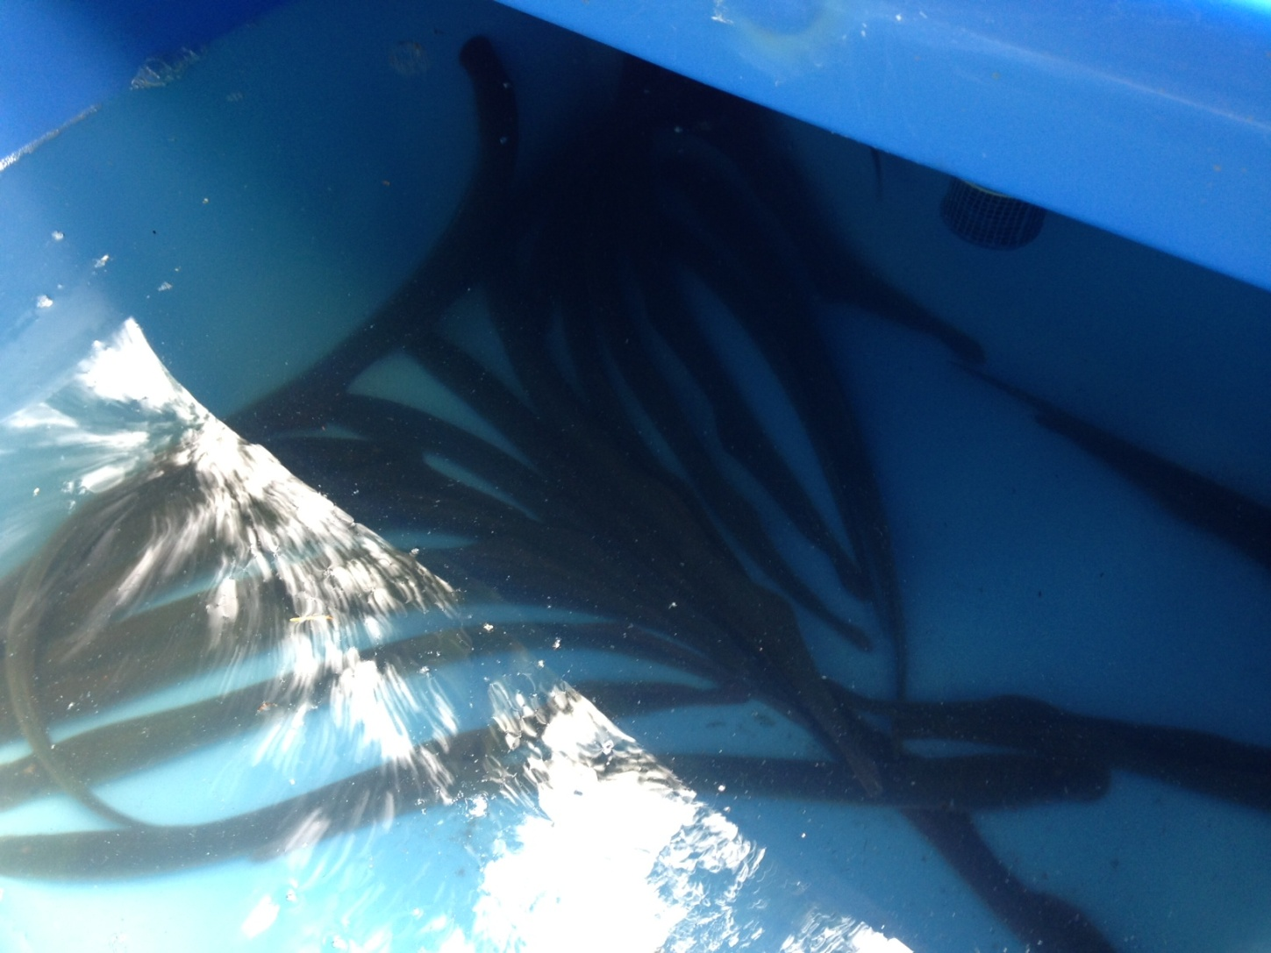
Pacific Lamprey Translocation
Confederated Tribes
of Grand Ronde
Adult Pacific lamprey - first arrival to Fall Creek

Slide 23
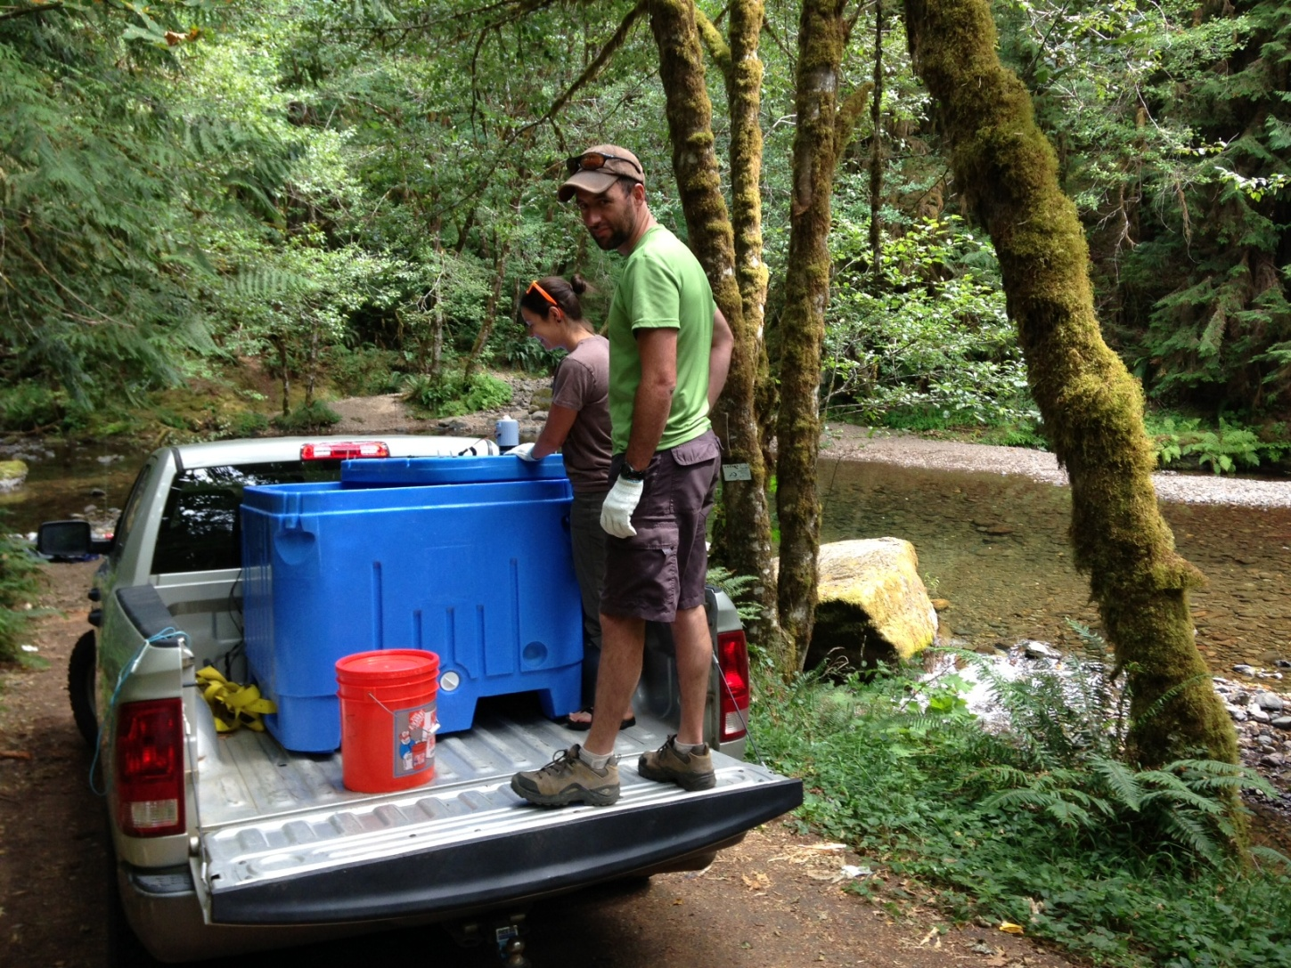
Pacific Lamprey Translocation
Confederated Tribes
of Grand Ronde
Fall Creek initial drop site (2013)

Slide 24
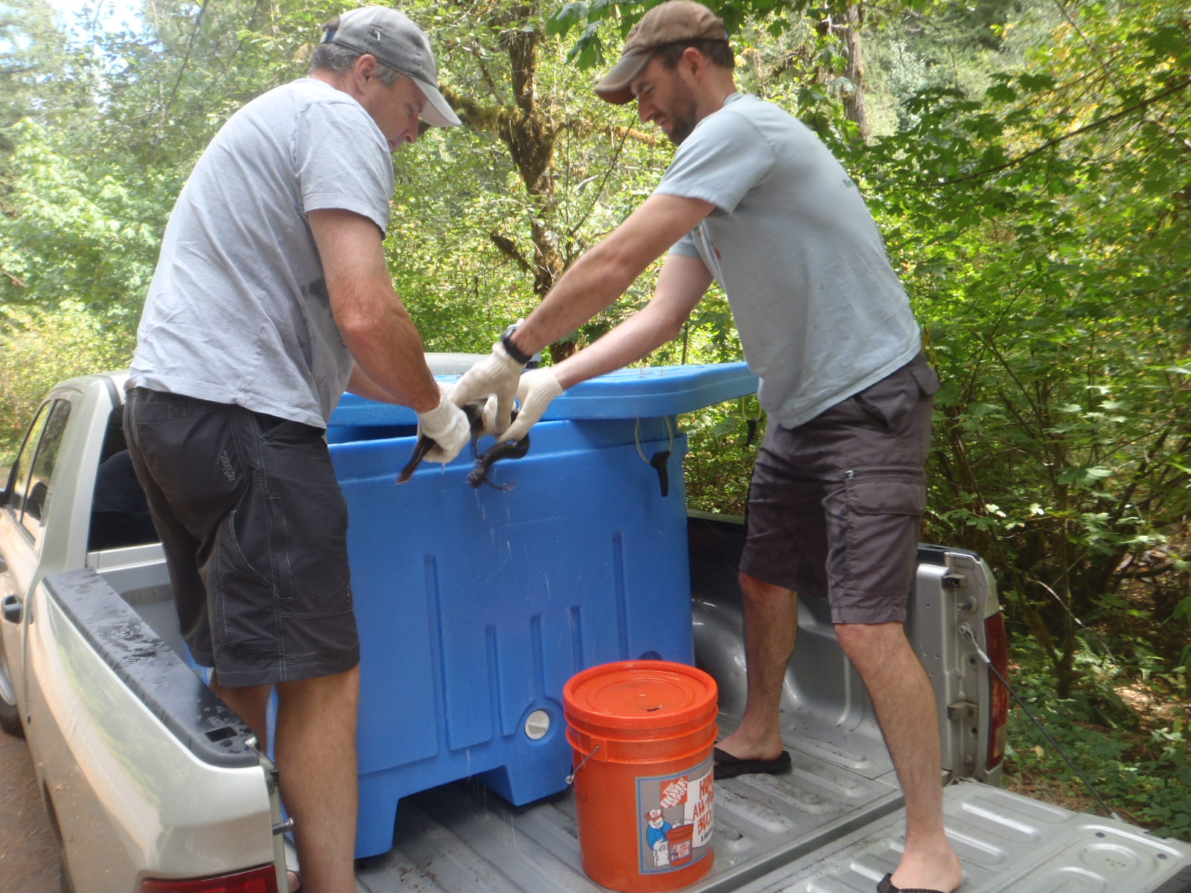
Pacific Lamprey Translocation
Confederated Tribes
of Grand Ronde
Fall Creek second drop site

Slide 25
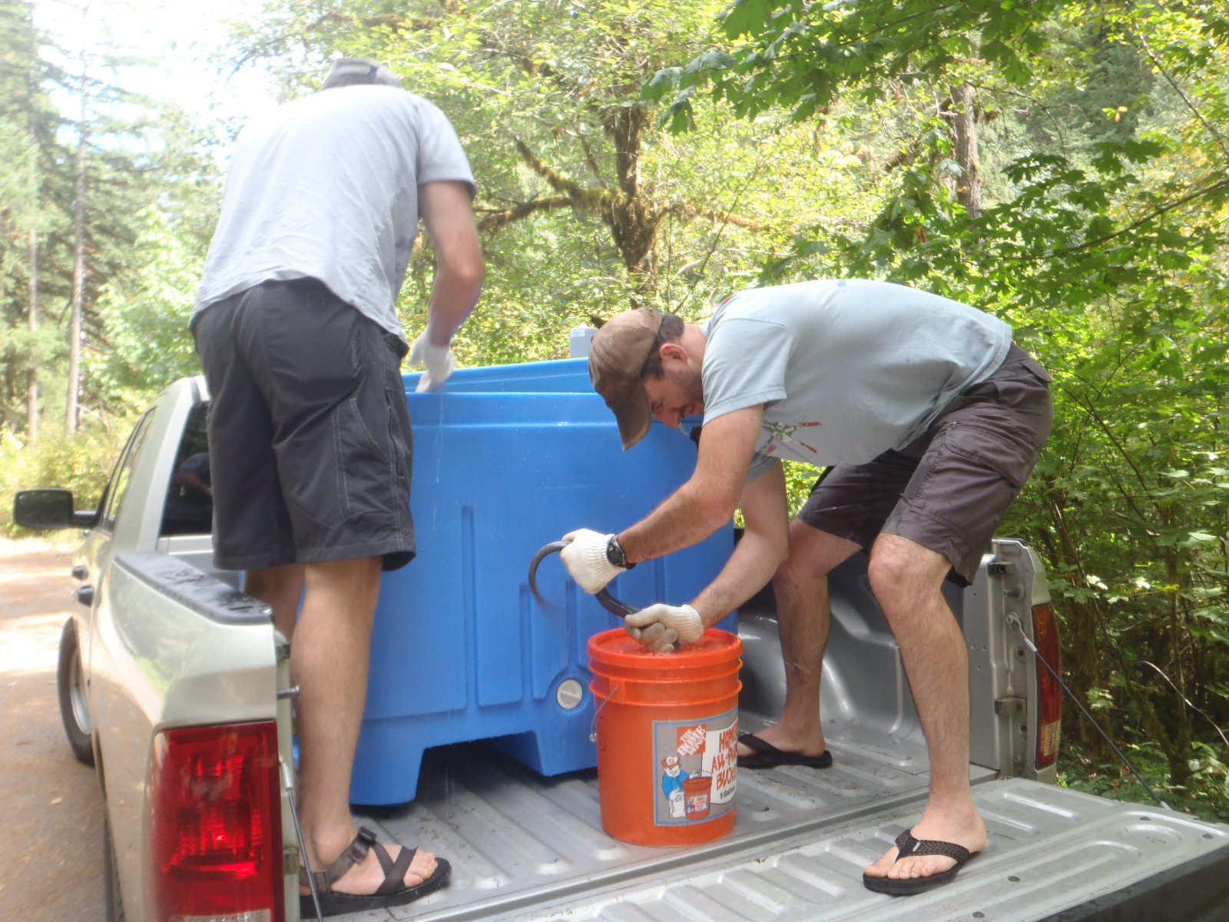
Pacific Lamprey Translocation
Confederated Tribes
of Grand Ronde
Fall Creek second drop site

Slide 26
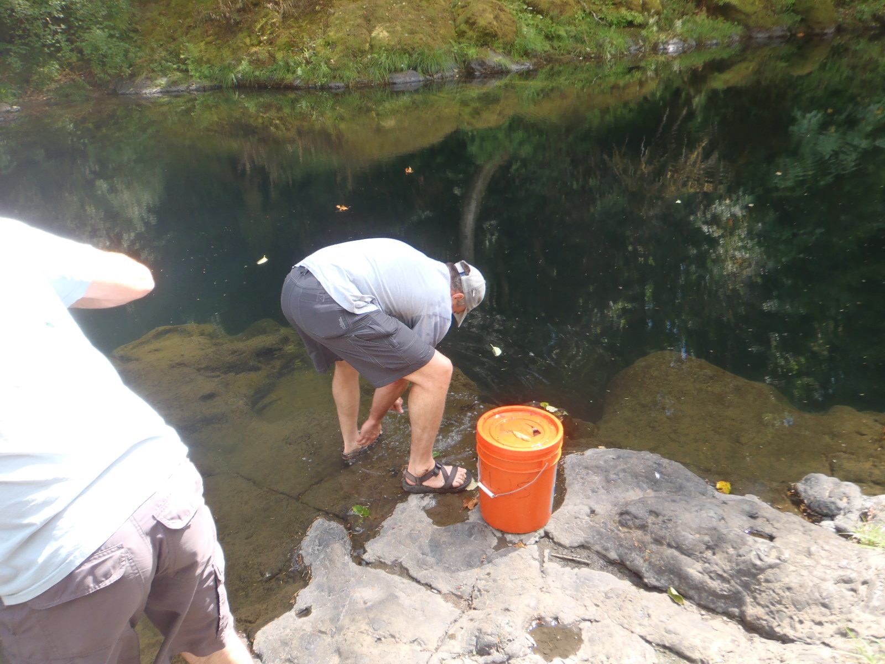
Pacific Lamprey Translocation
Confederated Tribes
of Grand Ronde
Fall Creek second drop site

Slide 27
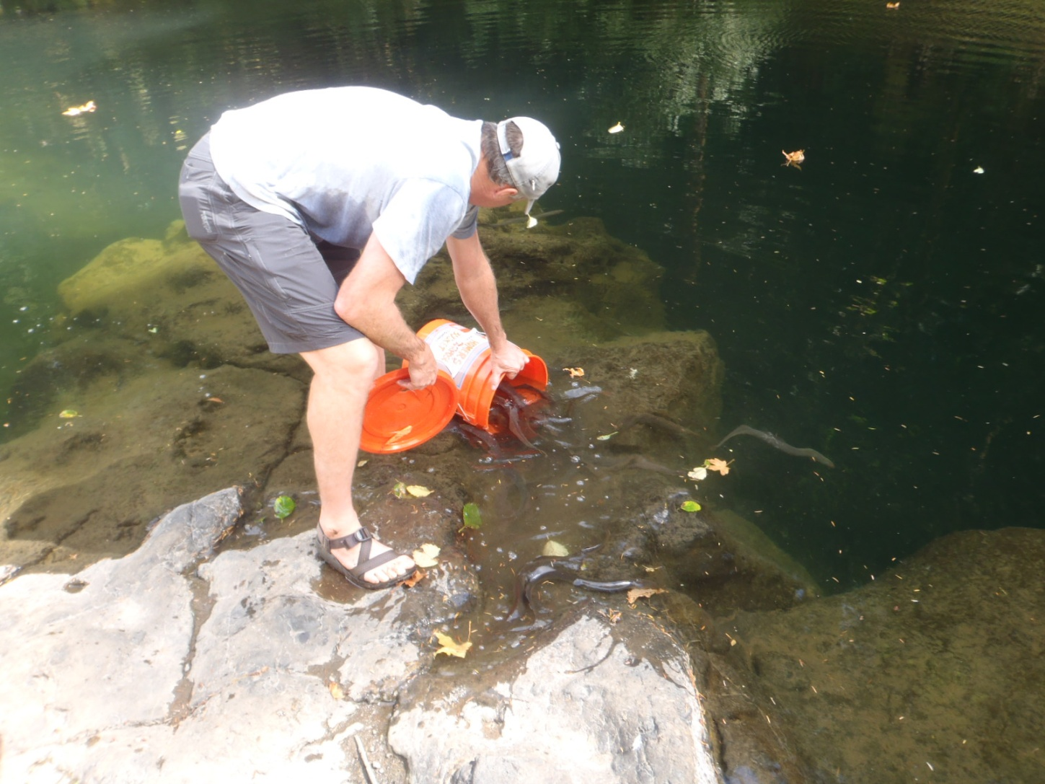
Pacific Lamprey Translocation
Confederated Tribes
of Grand Ronde
Pacific lamprey release

Slide 28
Pacific Lamprey Translocation
Confederated Tribes
of Grand Ronde
Pacific lamprey release

Slide 29
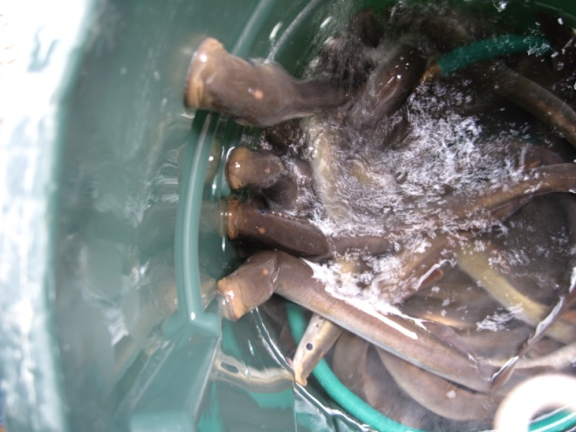
Pacific Lamprey Translocation
Confederated Tribes
of Grand Ronde
2013 Pilot Study Summary
Total 240 adults translocated
Five separate trips
August – September
None marked, tagged,
or sampled

Slide 30
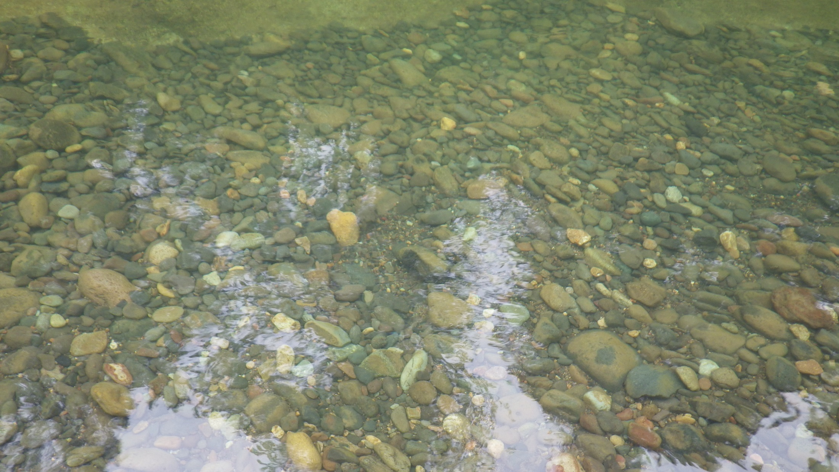
Pacific Lamprey Research
Confederated Tribes
of Grand Ronde
Notes:
Cut or move

Slide 31
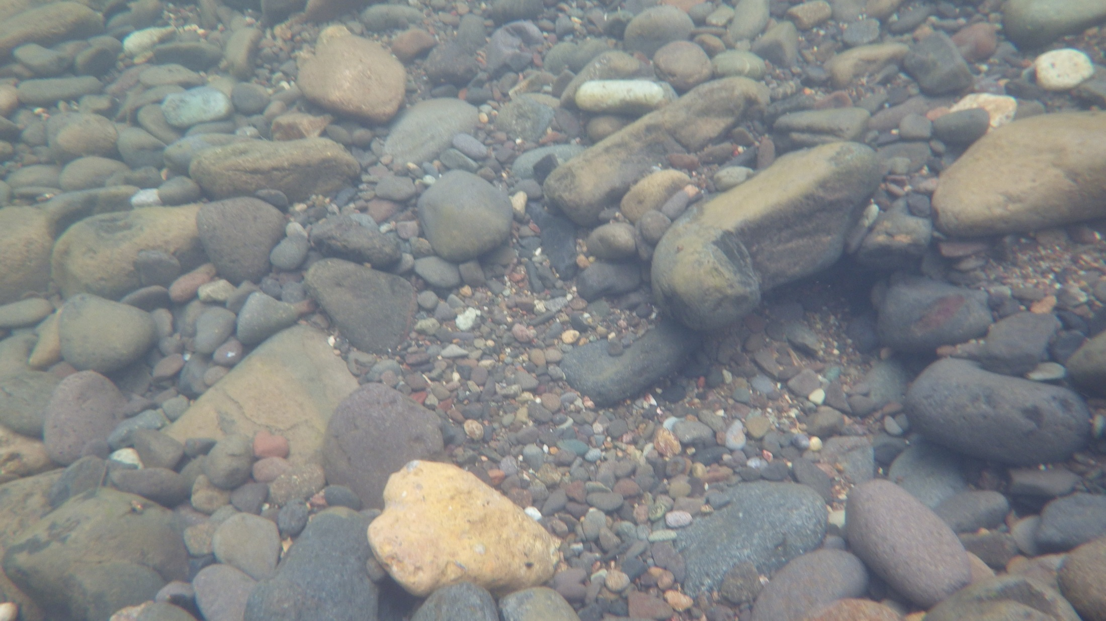
Pacific Lamprey Research
Confederated Tribes
of Grand Ronde
Notes:
Cut or move

Slide 32
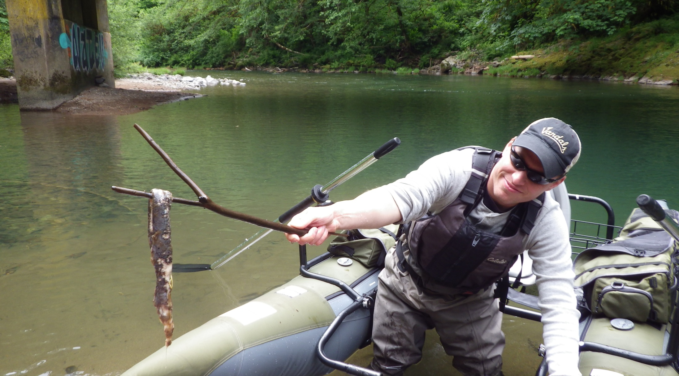
Pacific Lamprey Research
Confederated Tribes
of Grand Ronde
Notes:
Cut or move

Slide 33
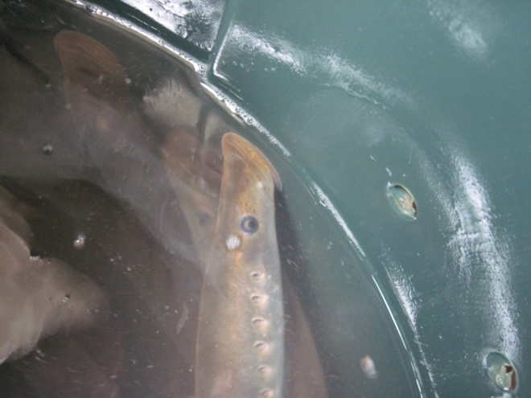
Pacific Lamprey Translocation Future Goals/Objectives
Confederated Tribes
of Grand Ronde
2014 Transported 240
Utilized radio-telemetry
Implanted 40 adults
Establish fixed telemetry receiver site at Dam
Compliment with mobile tracking
Pre-spawning mortality/areas of use
Conduct spawning surveys
Full study
One life cycle – 7 years
Continue translocating each year

Slide 34
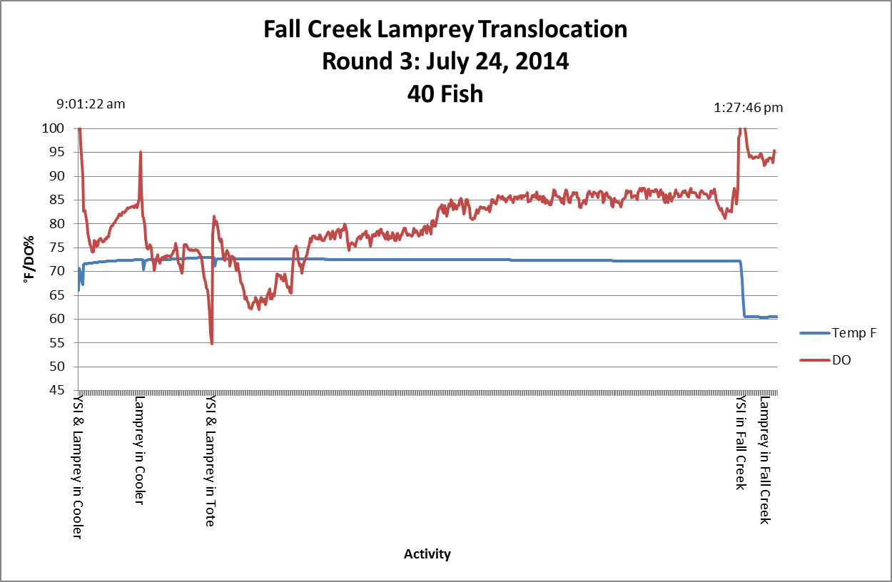
Pacific Lamprey Translocation
Confederated Tribes
of Grand Ronde

Slide 35
Pacific Lamprey Translocation
Confederated Tribes
of Grand Ronde

Slide 36
Current Distributions
Confederated Tribes
of Grand Ronde
Key
Individual
Group of 2
Group of 3
Group of 4

Slide 37
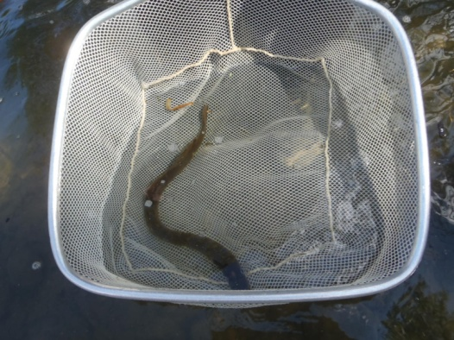
Pacific Lamprey Translocation Future Implications
Confederated Tribes
of Grand Ronde
Fall Creek as case study
Ideal study area
High quality, historic spawning habitat
Draw-down for juvenile outmigration
Likely adults already utilize area below dam
Passage potentially low-cost
Minimal modifications
Truck and haul
Use applications elsewhere
Other dams

Slide 38
Pacific Lamprey Translocation Future Implications
Confederated Tribes
of Grand Ronde
Special Thanks To
Oregon State
USACE
USFWS

